Slide 1
CODE-A-THON
Nano Techies

Slide 2

Automated Payload System
BY:
Diyaa Santosh
Lakshmi Priyadarshini M
Sachitha C
R Kavin Aravindhan

Slide 3

PROBLEM STATEMENT
Payload system - Store feature validation Automation for Wheel loaders.
A payload system has a display where the values (bucket weight,payload weight, pass count) is be updated.
Once the pass count value is incremented store functionality needs to be invoked automatically and this needs to be validated.

Slide 4
01
APPROACH

Slide 5
Loader parameters updated on UI screen
Simulation in a real-time environment.
Automation of store option based on given condition
Logging the values on a remote desktop

Slide 6
02
TECHNOLOGY STACK

Slide 7




Slide 8
03
SOLUTION

Slide 9
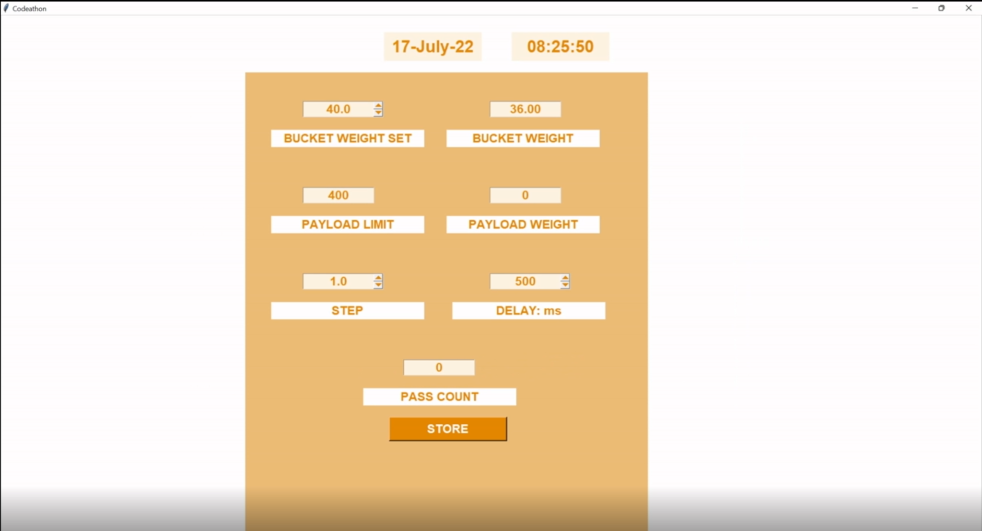

Slide 11


Slide 12
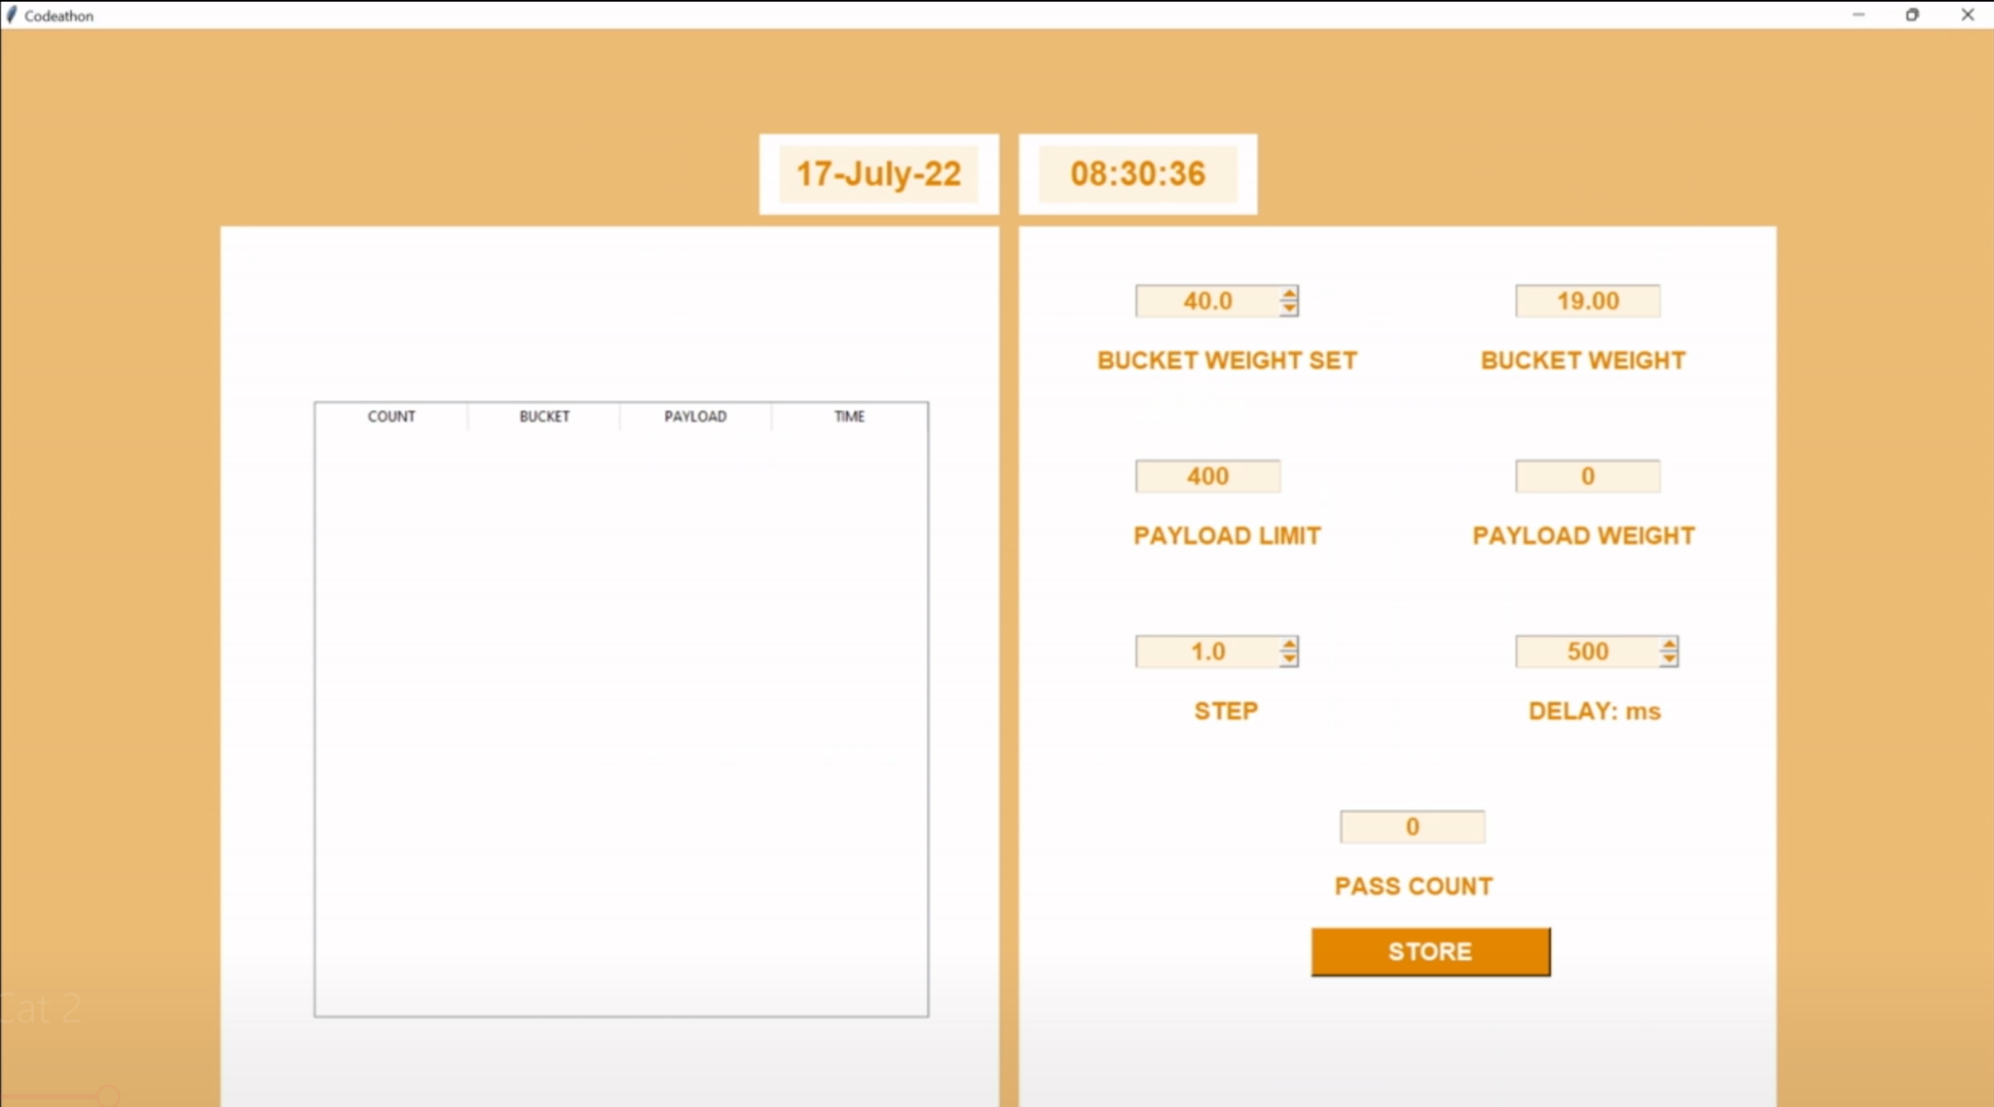

Slide 13


Slide 14
04
LEARNING

Slide 15
How a wheel loader payload system works ?
What are the multiple parameters ?
How to simulate incremental values in an application using Tkinter and python?
How much automation helps to build an effective solution?
Recording real-time data in a simulated environment.

Slide 16
05
CHALLENGES

Slide 17
Deciding which technology stack to go with to build a better solution
Simultaneous running of application in a remote desktop environment and automation script

Slide 18
06
WHY DID WE CHOOSE?

Slide 19
Known domain of technical knowledge
Excitement of Wheel loaders
Automation

